Slide 1
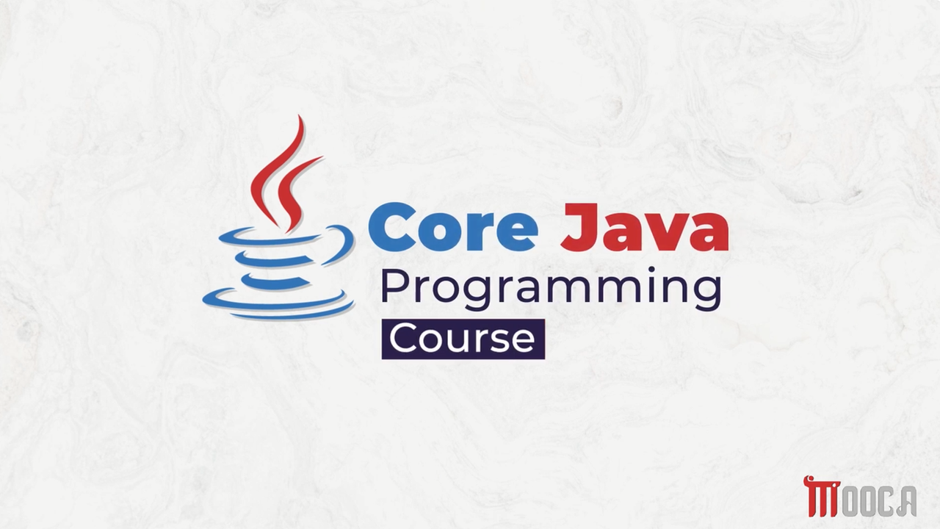

Slide 2
✍Lecture 8 :
Introduction to Generic Programming
Simple Generic Example Demo
Bounded Type Parameters
Wildcards
Lambda Expressions
Single Lambda Expressions
Block Lambda Expressions
Method Reference
Examples of Method Reference types

Slide 3
✍Lecture 9 :
Java collection
Iterators
Generic Utility Methods
Collection Framework interface
Linked Lists
Maps
Map Interface Method
Algorithms

Slide 4
✍Introduction to Java Collection Framework
Java provides ready-made data structures that help us store and manage groups of objects.
Before choosing a collection, ask:
Do I need fast searching?
Do I need fast insertion/removal?
Do I need to store key-value pairs?
Do I care about the order of elements?

Slide 5
✍Java Collections Framework
Why Collections?
Java provides collection classes to make working with data structures easier.
The Collections Framework separates:
Interface → What the collection can do
Implementation → How the collection does it

Slide 6
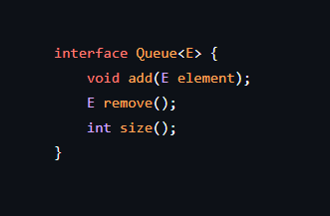
✍Queue: A Simple Example
A Queue follows:
FIFO
First In → First Out
A Queue interface provides operations such as:
add()
remove()
size()

Slide 7
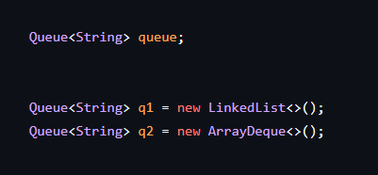


✍Queue Interface vs Implementation
Queue = Interface
Possible implementations:

Slide 8











✍Queue Implementations
Circular Array
Uses an array.
Has a fixed/bounded capacity.
Efficient when the maximum size is known.
Linked List
Uses linked nodes.
Can grow dynamically.
Useful when the number of elements is not limited.

Slide 9
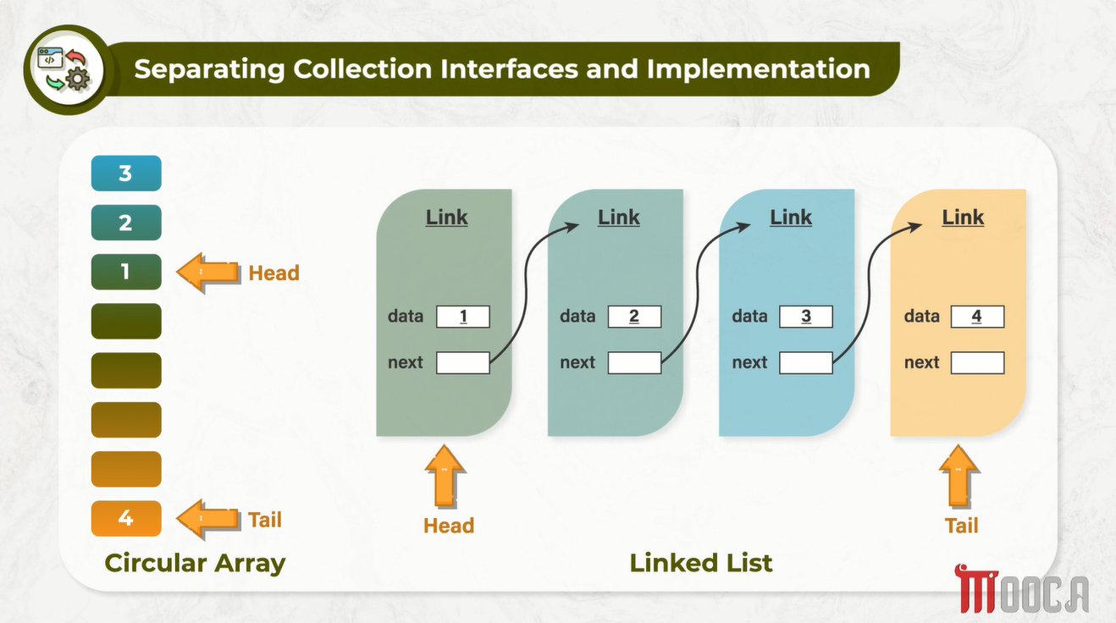







Slide 10
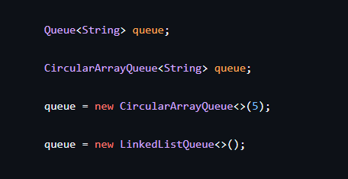



✍Programming to an Interface
Instead of …
We can choose the implementation:

Slide 11
✍Why Separate Interface and Implementation
Benefits
Flexibility
Easier maintenance
Easier to change implementation
Hides implementation details
Supports polymorphism

Slide 12





✍Iterator
An Iterator is used to visit collection elements one by one.
Main methods:
hasNext()
next()
remove()
forEachRemaining()

Slide 13
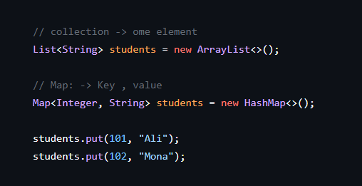



✍Interfaces in the Collections Framework
The Java Collections Framework provides several interfaces for different types of collections.
The two main interfaces are:
Collection
Map
Collection stores individual elements.
Map stores key-value pairs.

Slide 14





✍Collection Framework Hierarchy
Map
HashMap
TreeMap
LinkedHashMap
Collection
List
Set
Queue

Slide 15





✍List & Set :
List
Ordered collection
Allows duplicate elements
Elements can be accessed by index
Set
Does not allow duplicate elements
Focuses on uniqueness

Slide 16


✍SortedSet and SortedMap
Sorted Collections
SortedSet maintains elements in sorted order.
SortedMap maintains mappings according to sorted keys.
Common implementations:
TreeSet
TreeMap

Slide 17
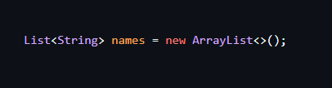
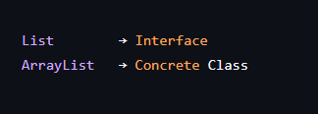



✍Concrete Collections
Concrete Collection Classes
Interfaces define the operations that a collection supports.
Concrete classes provide the actual implementation.
Examples:
ArrayList
LinkedList
HashSet
TreeSet
PriorityQueue

Slide 18
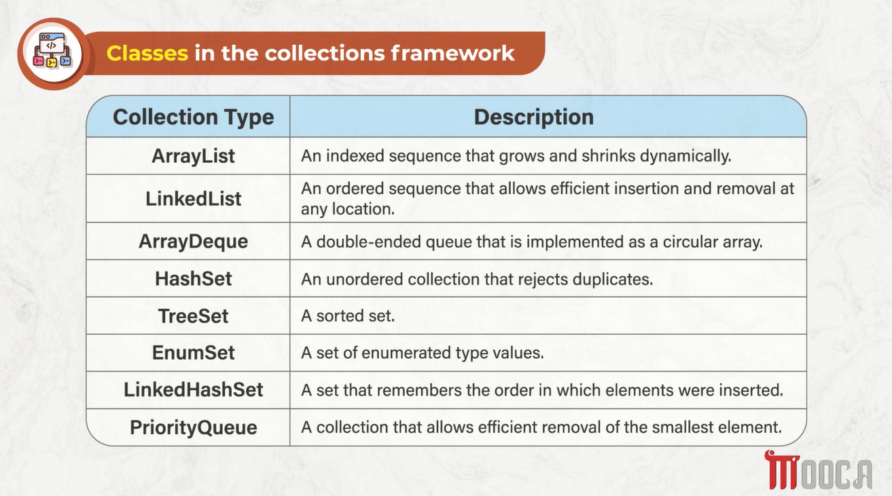

Slide 19
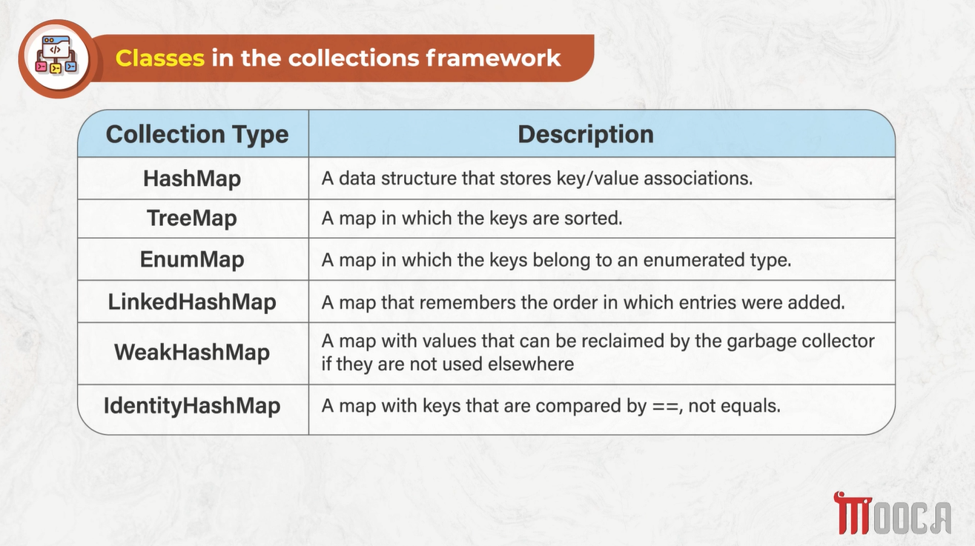

Slide 20
✍Classes in Collections Framework
Class | Main Idea
ArrayList | Resizable array
LinkedList | Doubly-linked list
HashSet | Unique elements
TreeSet | Sorted unique elements
LinkedHashSet | Unique + insertion order
PriorityQueue | Priority-based queue

Slide 21
✍Map Classes
Class | Description
HashMap | Fast key-value lookup
TreeMap | Sorted keys
LinkedHashMap | Maintains insertion order
WeakHashMap | Keys can be garbage collected
IdentityHashMap | Compares keys using ==

Slide 22
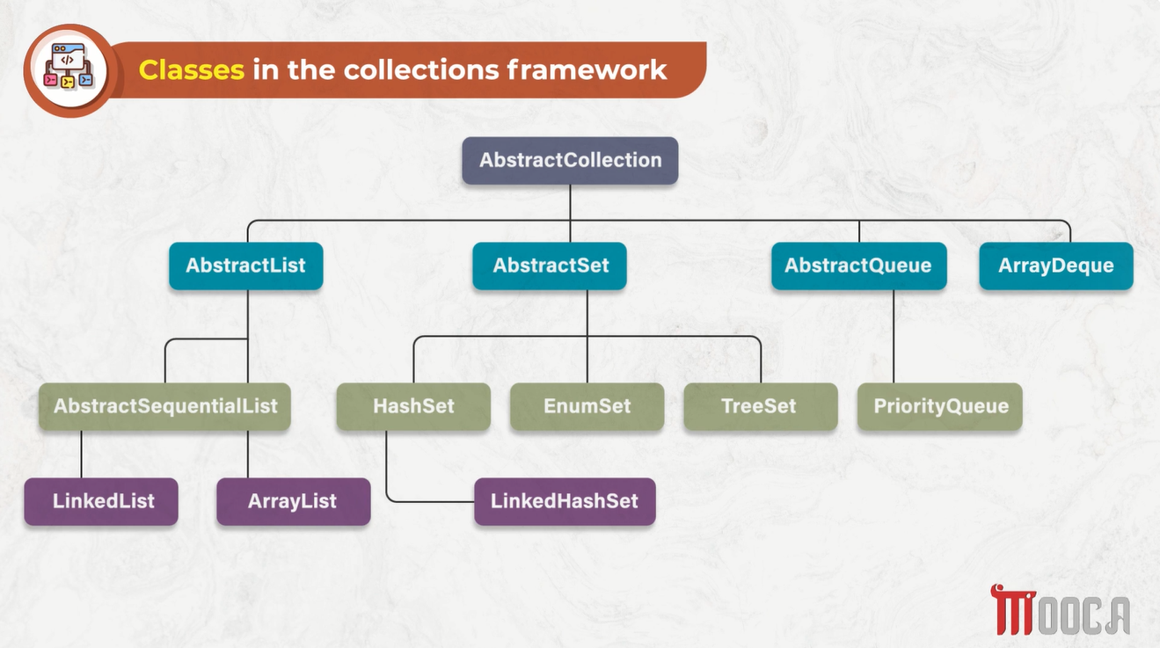



Slide 23
✍Linked Lists
ArrayList stores elements using a dynamic array.
LinkedList stores elements in linked nodes.
Inserting or removing elements can be efficient when the position/node is known.
Random access by index is slower than in ArrayList.

Slide 24


✍Why LinkedList
Efficient insertion/removal at known positions.
No need to shift many elements like an array-based list.
Sequential traversal is natural.
Random access using get(index) can be expensive.

Slide 25



✍ ListIterator
ListIterator:
ListIterator extends Iterator.
It can traverse a list in both directions.
It supports insertion and removal during traversal.

Slide 26


✍Efficient vs Inefficient Operations
Efficient
Add/remove at the beginning or end.
Add/remove using a known iterator position.
Less Efficient
Random access using get(index).
Searching for an element.

Slide 27
✍Concurrent Modification
An iterator expects the collection structure to remain unchanged during traversal.
Modifying the collection directly while using an iterator may cause ConcurrentModificationException.
Use the iterator's remove() method for safe removal during traversal.

Slide 28


✍What is a Map
A Map stores key-value pairs.
Each key is unique.
A key is used to retrieve its associated value.
Common implementations:
HashMap
TreeMap

Slide 29


✍HashMap vs TreeMap
HashMap | TreeMap
Uses hashing | Uses ordering
Fast lookup | Keeps keys sorted
No ordering guarantee | Sorted by keys

Slide 30
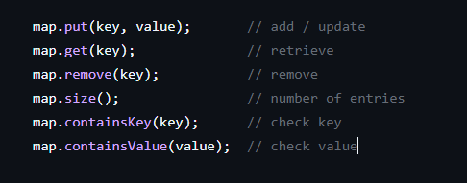

✍Basic Map Operations

Slide 31
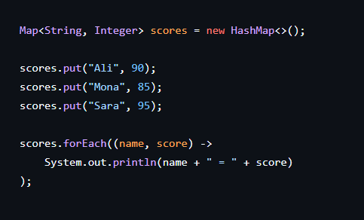
✍Iterating Through a Map

Slide 32
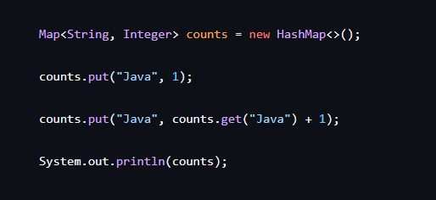

✍Updating Map Entries

Slide 33
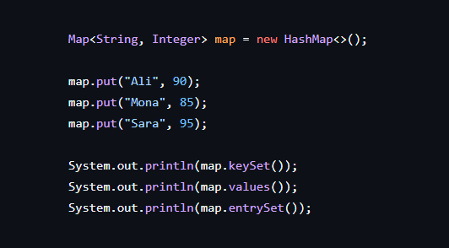

✍Map Views
A Map provides three views:
map.keySet()
map.values()
map.entrySet()

Slide 34
✍Algorithms in Collections
Algorithms
The Collections Framework provides algorithms for common operations:
Finding maximum/minimum
Sorting
Shuffling
Binary search

Slide 35
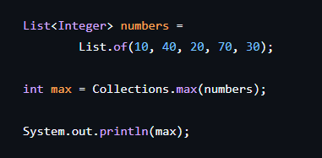


✍Finding Maximum
Also can find min;

Slide 36







✍Binary Search
Works on a sorted collection.
Repeatedly checks the middle element.
Eliminates half of the search space each time.

Slide 37


✍Legacy Collections
Older collection classes include:
Vector
Stack
Hashtable
Properties
They were introduced before the modern Collections Framework.

Slide 38
